Slide 1



Benteen
Elementary School
Weekly Construction Progress Report
Week 06/19/2023-06/23/2023

Slide 2

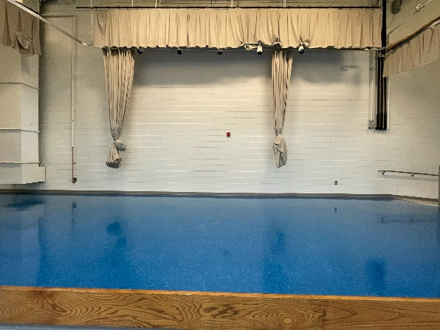
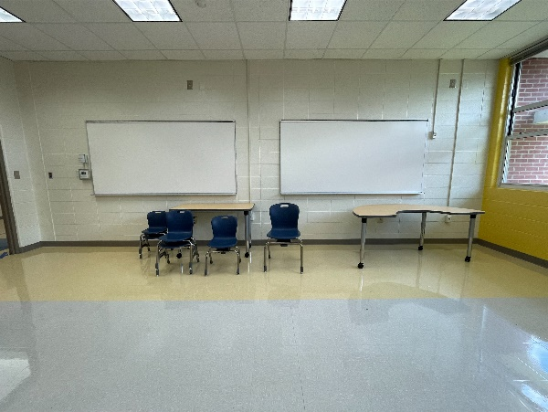

Current Activities 06/19/2023-06/23/2023
Fire Alarm Testing and Troubleshooting – Ongoing
Owner / Architect / Engineer Punch walk
Move-in Classroom Furniture - Ongoing
Electrical Final Inspection - Completed
Air Handling Units Install - Ongoing
Install Fencing – Outside Air Units
Install Kitchen Equipment
Wax stage – Area A
Wax Gymnasium’s Stage
Upcoming Activities 06/26/23-06/30/23
Install River rock gravel around ground HVAC Units
Mechanical and Plumbing Final Inspections
Rooftop HVAC start-up
Paint Gas Line
Classroom Furniture currently moving in

Slide 3
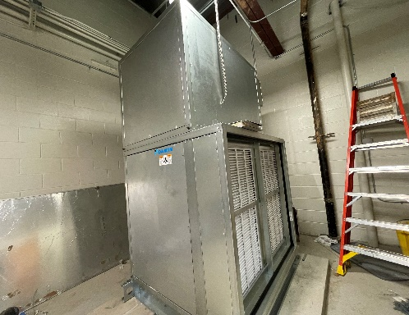
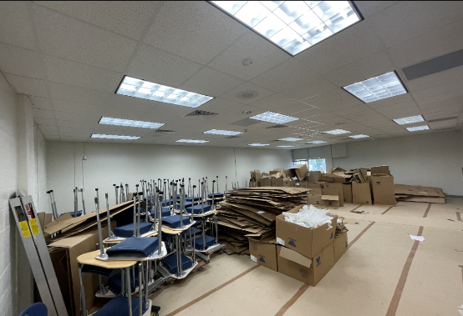
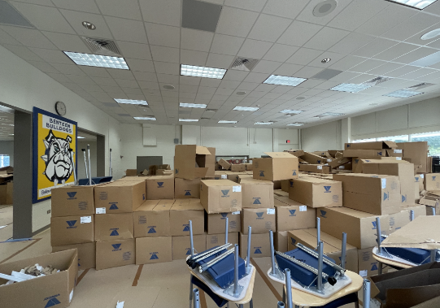
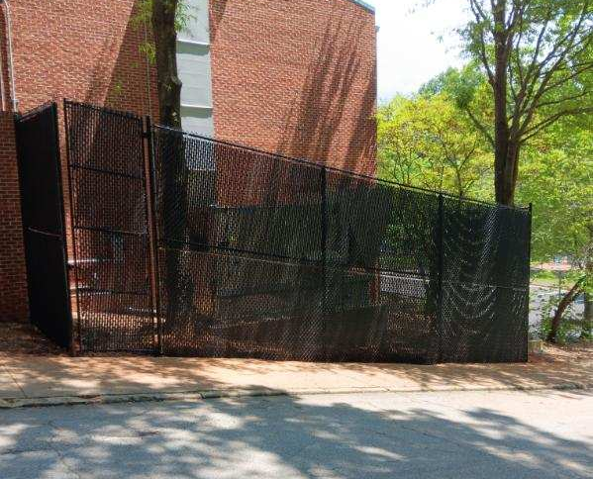
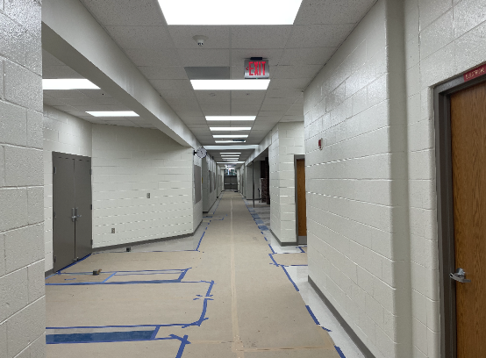
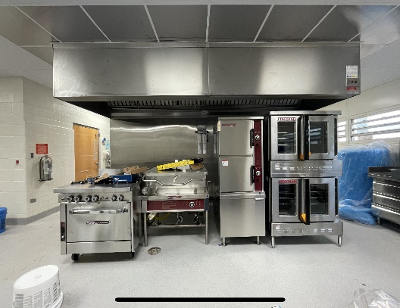
Progress Photos
Install Air Handling Unit in the Gym
New Classroom Furniture Setup Prep
New Classroom furniture delivery
Install Fencing for Outside Air Units
Floor Protection for Furniture Installation
Installation of Kitchen Equipment

Slide 4
Project Schedule
Schedule Status: On Schedule
Project Financials
Construction GMP: $9,989,727.77
Progress Billed to Date: $7,734,405.60
Budget Status: Within GMP

